Slide 1
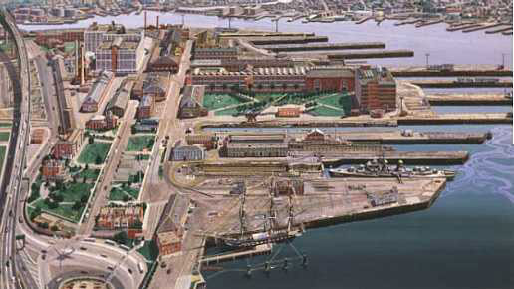
Smart growth at the Navy Yard?
Photo: www.nps.gov
Michael Grealish and Kimberly Holmes

Slide 2
EPA’s Objective for Clean water
Protect human health
Protect and restore watersheds and aquatic ecosystems
Key focus areas:
Develop a baseline for progress
Increase protection of healthy waters
Restore degraded waters
Reduce pollution from discrete sources
Enhance watershed resiliency and revitalize communities

Slide 3
How to apply goals to working piers
Within the pier 5 master plan incorporate the following:
Soft structures integrated with the hard structures
Main focus of the research center could be to develop watershed strategies for smart growth and plans to combat sea level rise problems
Include all of the Navy yard for soft structuring

Slide 4
“Soft structures”
Use the natural slope under the piers to “restore” the area into possible salt marshes, eel grass and oyster reef, thus improving the water quality!
Photo: www.bofep.org with paint addition by Michael Grealish

Slide 5
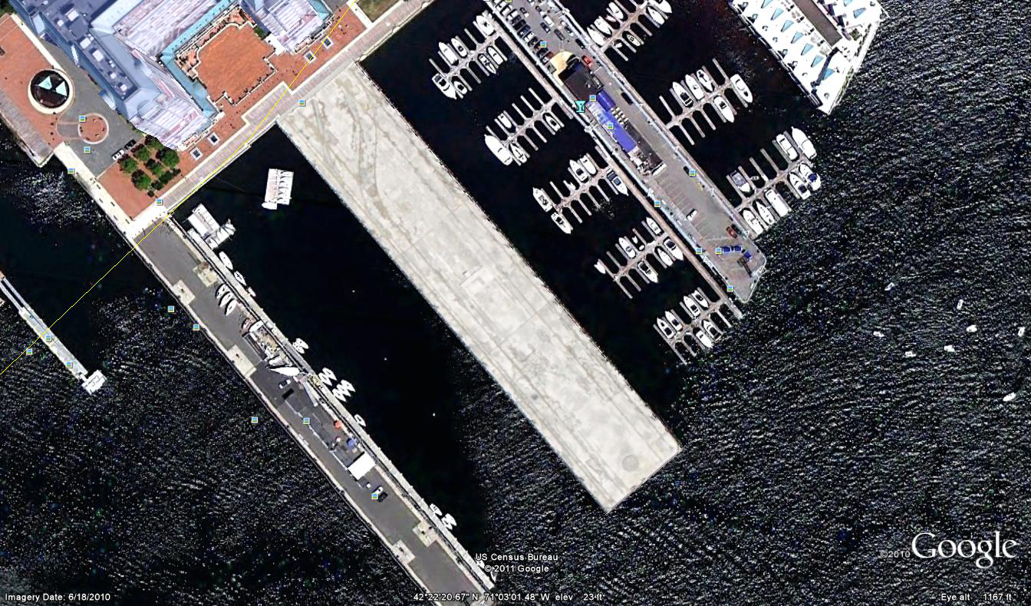
“Soft Structures” continued
On the pier and part of the proposed “discovery center” could be views of what lives and grows beneath the pier that could improve water quality.
Photo: Google Earth

Slide 6
Hard Structure and Green technologies
Considering the EPA’s plans for a clean watershed, the Navy Yard would include:
Green infrastructure approaches
Become a model for sustainable buildings as well as a working coastline
Encourage sustainable water management practices in support of the Clean water and drinking water sustainability policy
Promote “Going Green” for our future throughout the state.

Slide 7
Working together with the watershed
The Navy yard is located at the mouth of the Mystic River and the Charles River therefore;
Paired with successful buffering and better water quality practices throughout the watersheds of the two rivers the Navy Yard could be the final buffer for water entering the harbor!
With community outreach and support, Pier 5 can become a symbol for Green Technology and help raise awareness about Smart Growth and what changes need to be made for Pier 5 and Boston Harbor.

Slide 8
References
Coming Together for Clean Water, The Challenges and Opportunities for protecting Americas Waters.
www.EPA.gov

